Slide 1

How to - Data acquisition

Slide 2
Goal of Data acquisition
Reliably and accurately record data from a variety of sensors to draw conclusions about the forces the car experiences to inform current and future design decisions.
How can you answer the questions:
What is the best gear ratio for the transfer case?
What is the best spring rate for the shocks?
What is the ideal wall thickness for a suspension member?

Slide 3
Answering the Questions
Math
Simulation
Data collection and analyzation
Attempt these first
Verify results

Slide 4
What capabilities does daq have?
Inertial measurement (IMU) -> 3-axis acceleration and 3-axis gyroscope in one
Rotational position/velocity -> This is probably easiest thing to measure
Linear position -> Primarily used for shock positions, use when can’t measure rotation
Pressure/Force -> Can be fluid pressure such as brake lines or 1-axis force measurement via load cell
Temperature -> Both contact and non-contact measurement (a lot of this is in development)

Slide 5
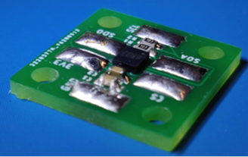
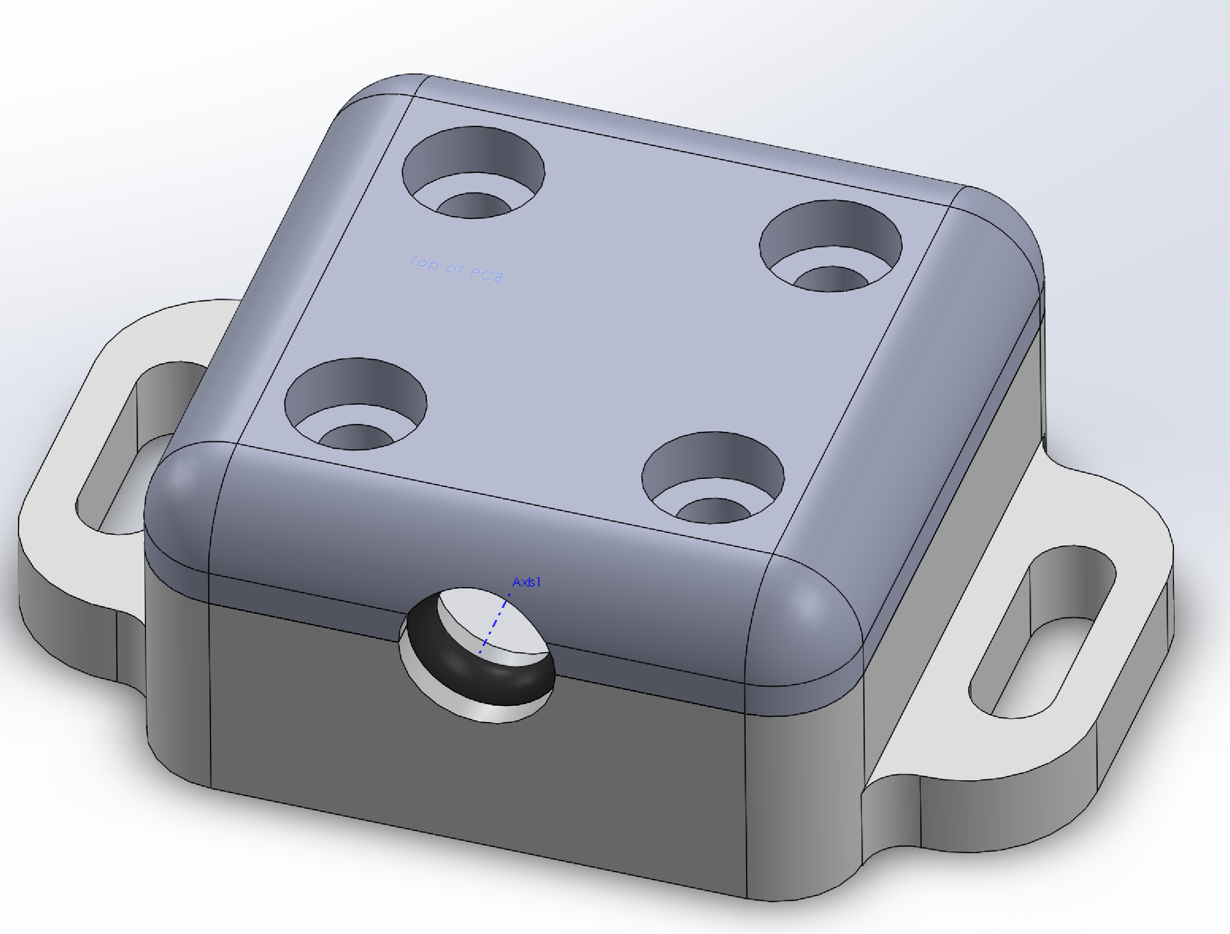
IMU
+- 16g’s
+-4000 degrees/s
Typical +- 10mg’s, +- 1 degree/s, 1% scaling error

Slide 6
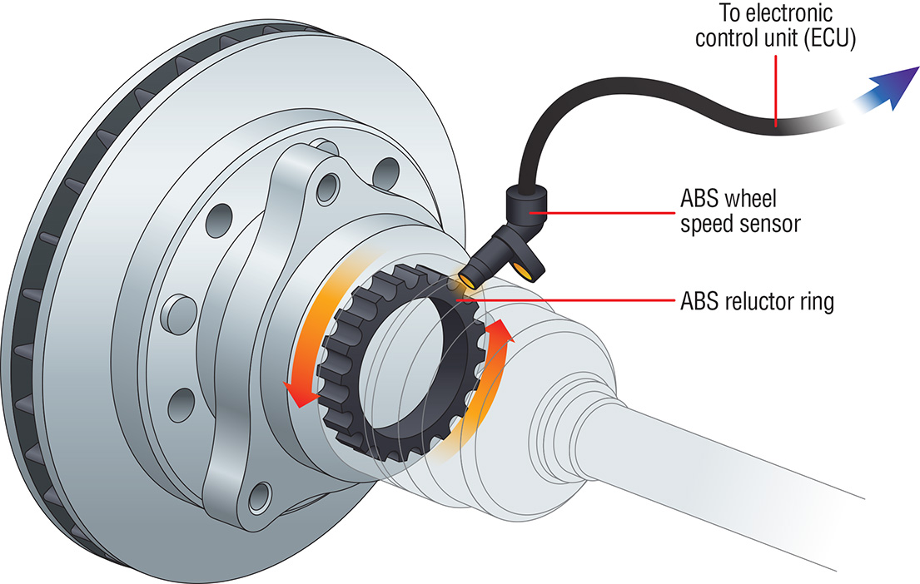
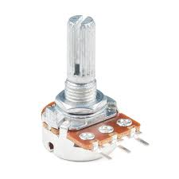
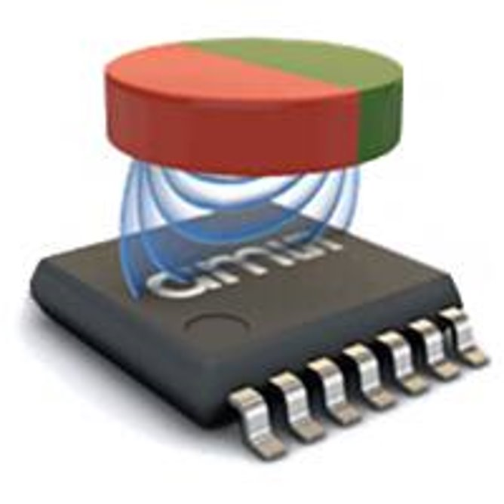
Rotational Measurement
Measure speed/position via a rotating magnet on the same axis as what is rotating
Measure speed perpendicular to shaft with a toothed wheel (such as a gear)
Measure position with a potentiometer on same axis as what is rotating

Slide 7
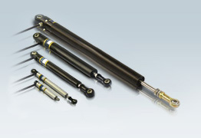
Linear position
Primarily use these sensors on shock positions because they are expensive (~$200)

Slide 8
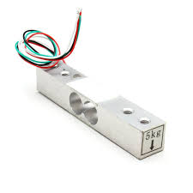
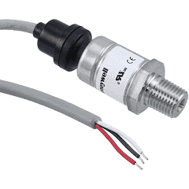
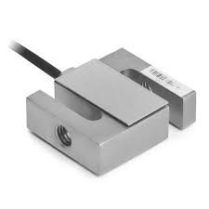
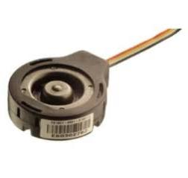
Pressure/force
Many varieties of pressure/force sensors
Measure force in tension/compression
Measure force as lever arm

Slide 9
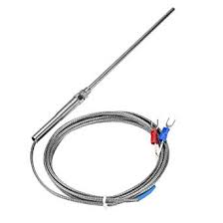
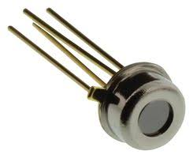
Temperature
Contact vs. non-contact measurement

Slide 10
Current system capabilities
Currently supports 200Hz measurement rate
Depending on sensor type, can typically support any from 6-30 sensors simultaneously
If higher measurement rates are desired, custom software and potentially custom hardware has to be designed so the sooner we know the better!
Our goal is to have a system set up to support whatever test you may want to run
If you anticipate wanting to run a test, let us know immediately!

Slide 11
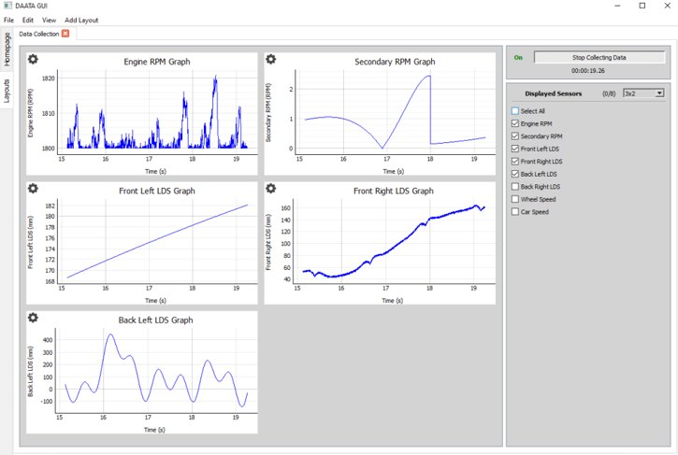
Wireless real-time data
In Spring, any member on our team will be able to download our custom data collection software so that they can visualize data they have collected in real time
Will also auto-import data into MATLAB for post-processing

